Slide 1
21 AIE214 Big Data Analytics End-Semester Project BATCH - A GROUP - 8 SUPERVISED BY: Dr.Sanjanasri.P

Slide 2
TOPIC:
BILLBOARD TOP 100 SONGS

Slide 3
TEAM MEMBERS:
01
02
Suda HariPriya - CB.EN.U4AIE21067
Sai Sri Darsini H - CB.EN.U4AIE21055
03
04
Sykam Sumanjali - CB.EN.U4AIE21068
Reddy Hema Radhika - CB.EN.U4AIE21050

Slide 4
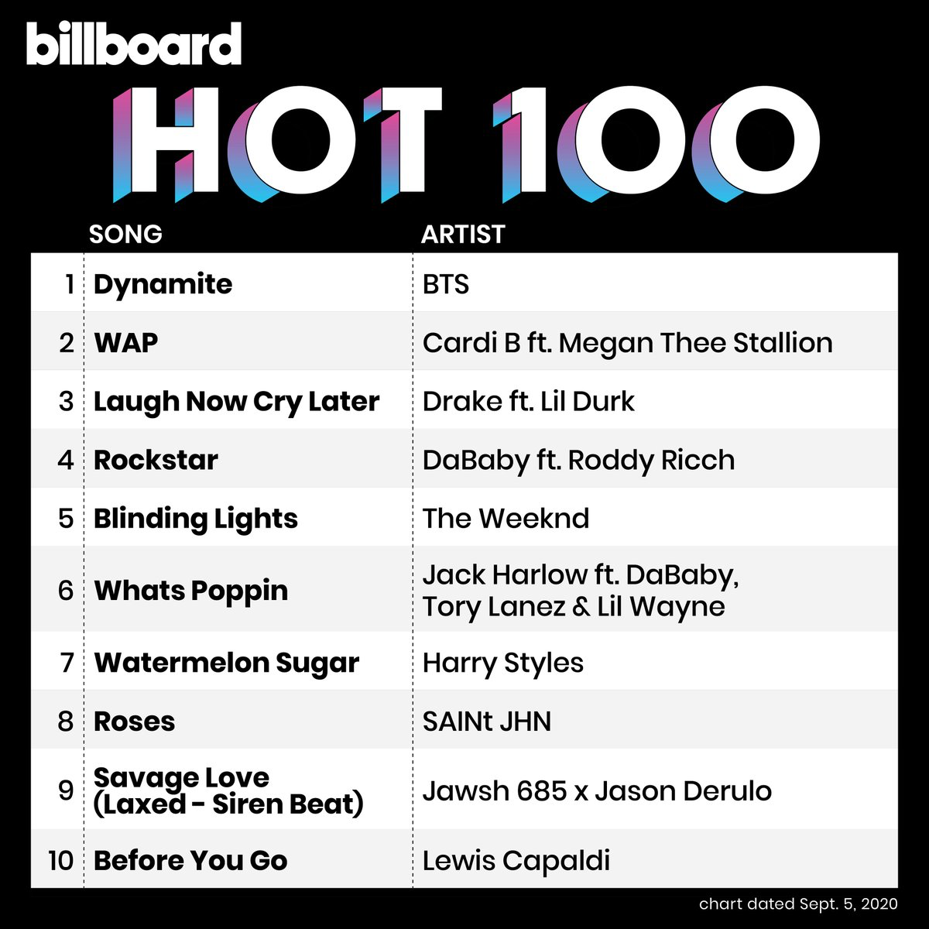
BILLBOARD TOP 100 SONGS:
Billboard Top 100 songs is a weekly chart that ranks the most popular songs in the US based on metrics such as sales, streaming, serving as a widely recognized measure of music popularity and success.

Slide 5
OVERVIEW OF THE DATASET:
BillBoard Top 100 Songs from 1991 to 2021.
Dataset consists of 7 features.
Size of Dataset:156823

Slide 6
Features:
WeekID
Week Position
Song
Performer
Previous Week Position
Peak Position
Weeks on Chart

Slide 7
Analysis
02
Extracting significant and meaningful insights from the dataset.

Slide 8
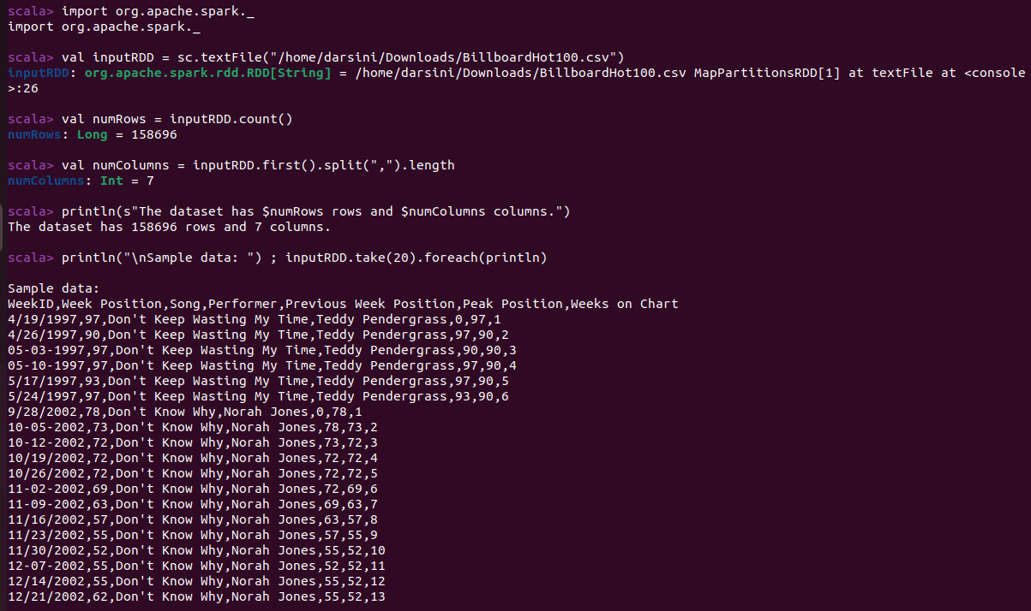
Importing the data

Slide 9
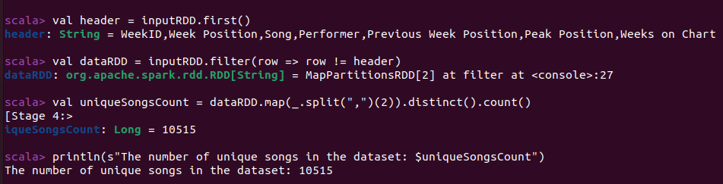
Unique songs

Slide 10
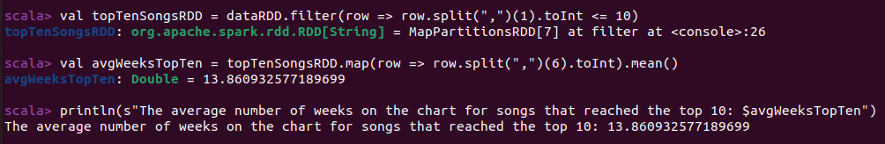
Average weeks for TOP 10 songs

Slide 11
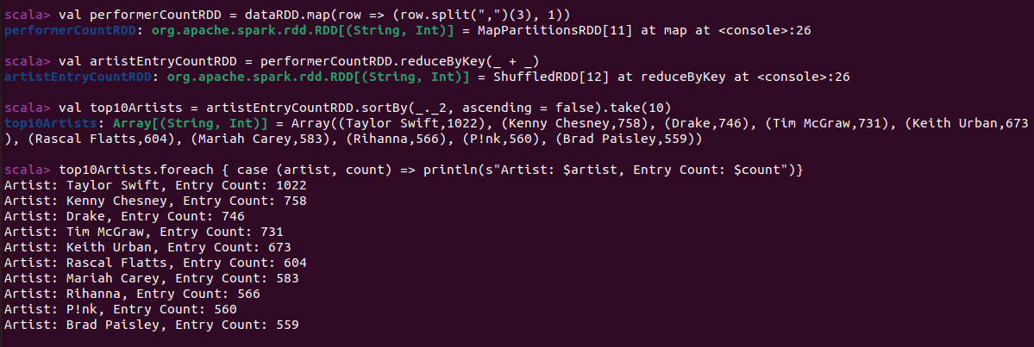
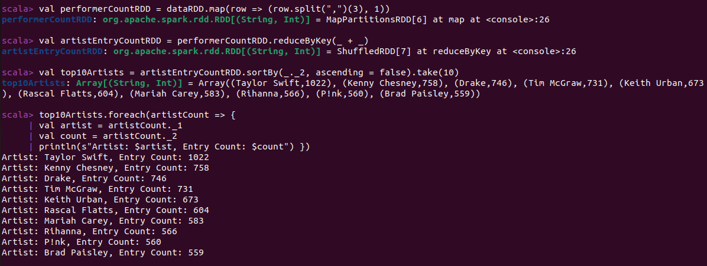
Artist entry count

Slide 12
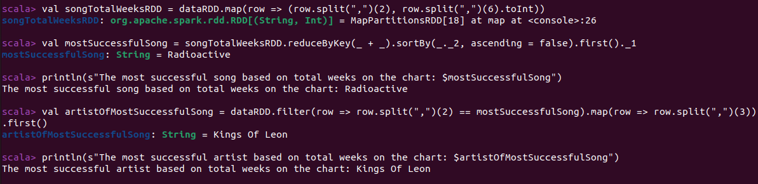
Successful artist and song based on weeks

Slide 13
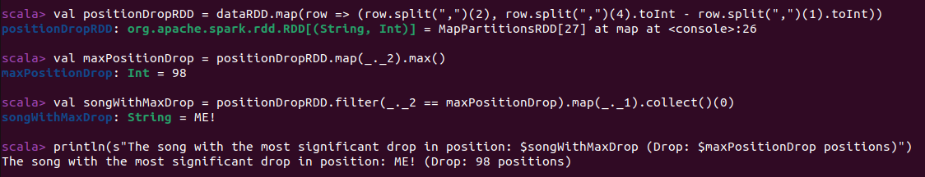
Significant drop

Slide 14
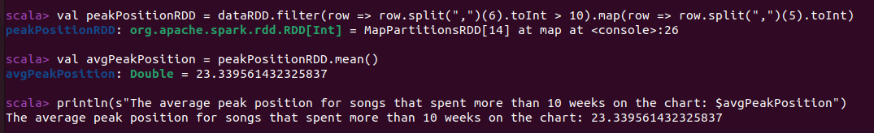
Avg peak position

Slide 15
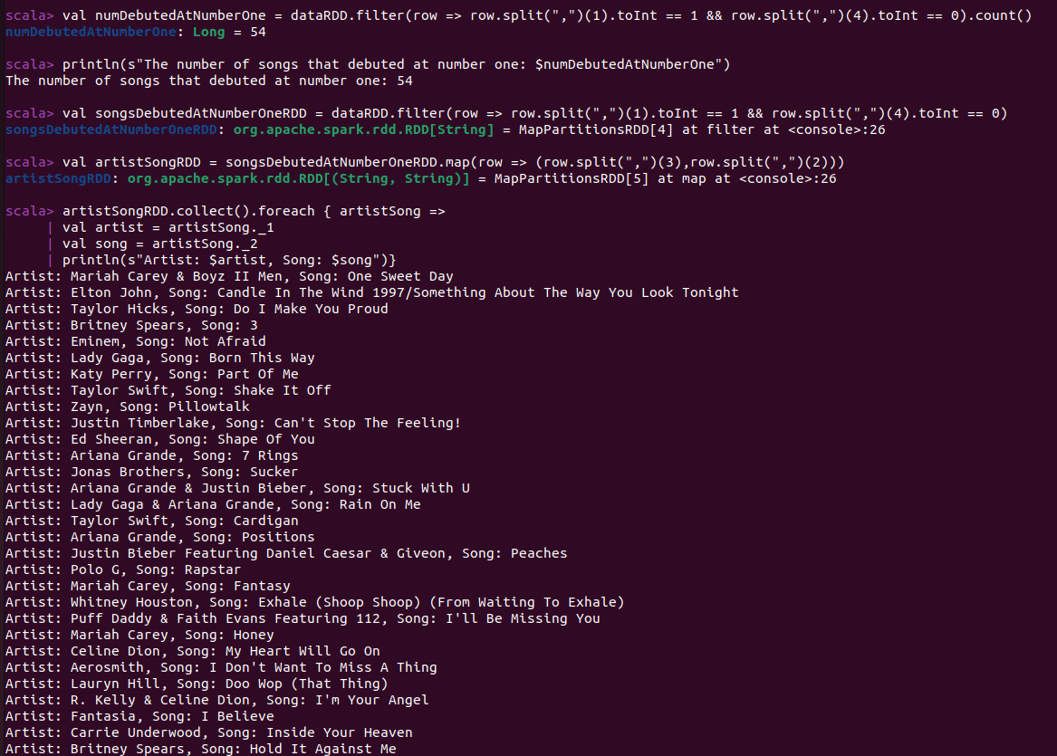
Songs debuted at No.1

Slide 16
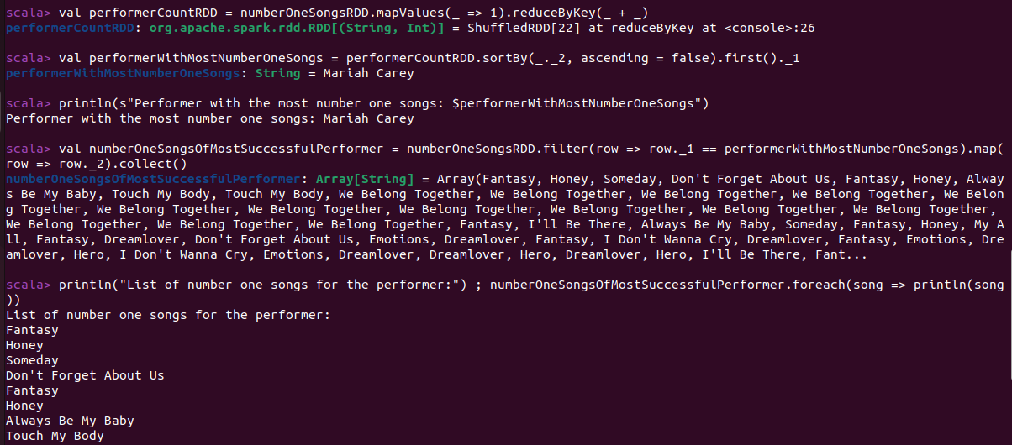
Artist with most No.1s

Slide 17
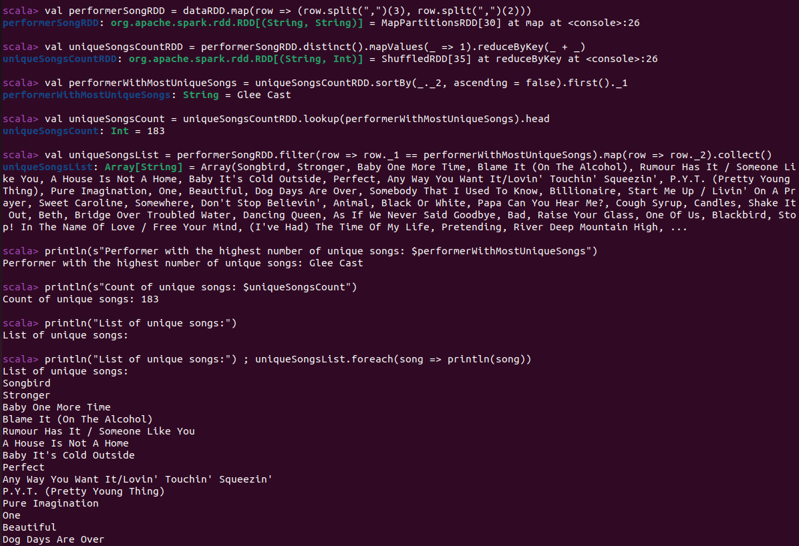
Most unique songs

Slide 18
THANK YOU MAM

